Slide 1
Autogene Update

Slide 2
Objective Function | # of CpG | EPCAM correlation | TIL correlation
Cohen2, condition number | 75 | R=0.81, P= 0.0079 | R=0.14, P=0.65
Cohen2, condition number | 200 | R=0.64, P= 0.019 | R=0.18, P=0.57
Cohen2, condition number | 400 | R=0.41, P=0.16 | R= -0.19,P=0.53
Cohen, condition number | 75 | R=0.42,P=0.15 | R= -0.24,P=0.44
Effectsize, condition number | 100 | R=0.41,P=0.1 | R=0.48,P=0.095
Effectsize, condition number | 200 | R=0.52,P=0.069 | R=0.12,P=0.69
Only condition number | 100 | R=0.72,P=0.0059 | R= -0.28,P=0.35
Only condition number | 200 | R=0.58, P= 0.038 | R= -.095,P=0.76
………………… | ……………. | ……………. | …………………………..

Slide 3
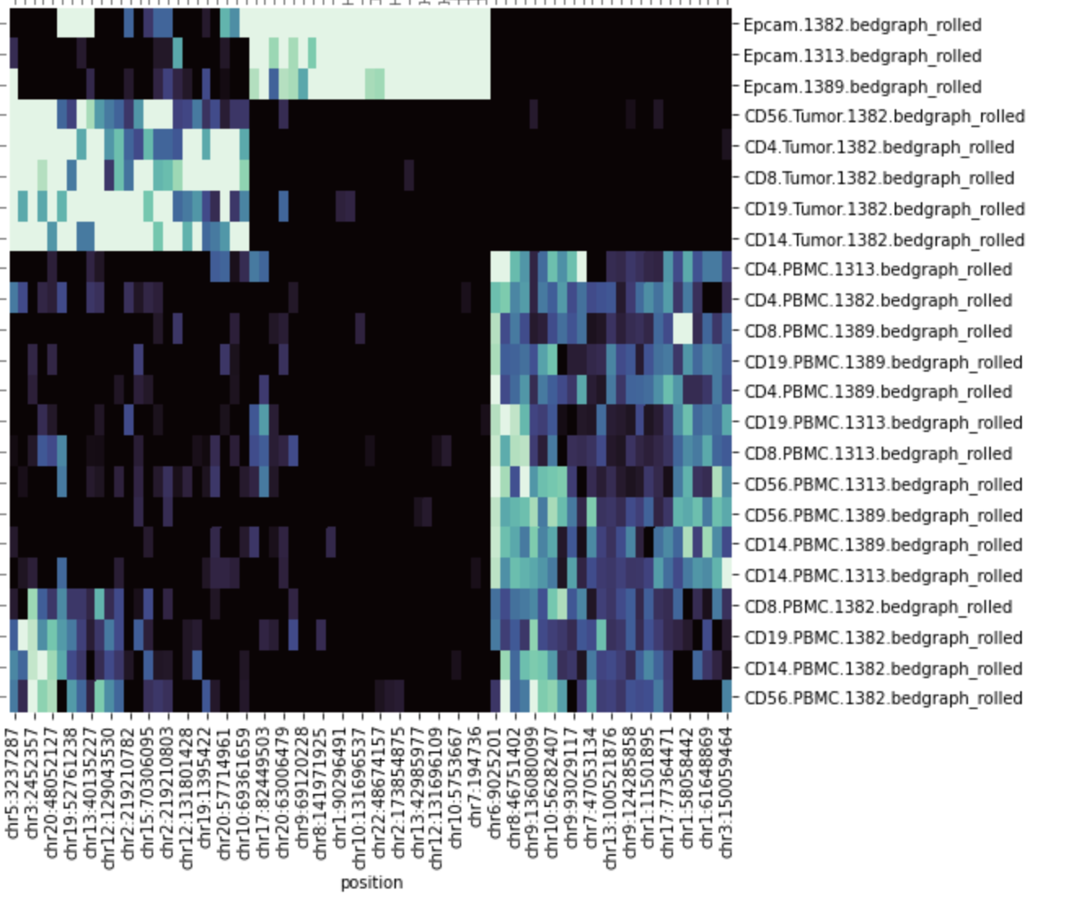
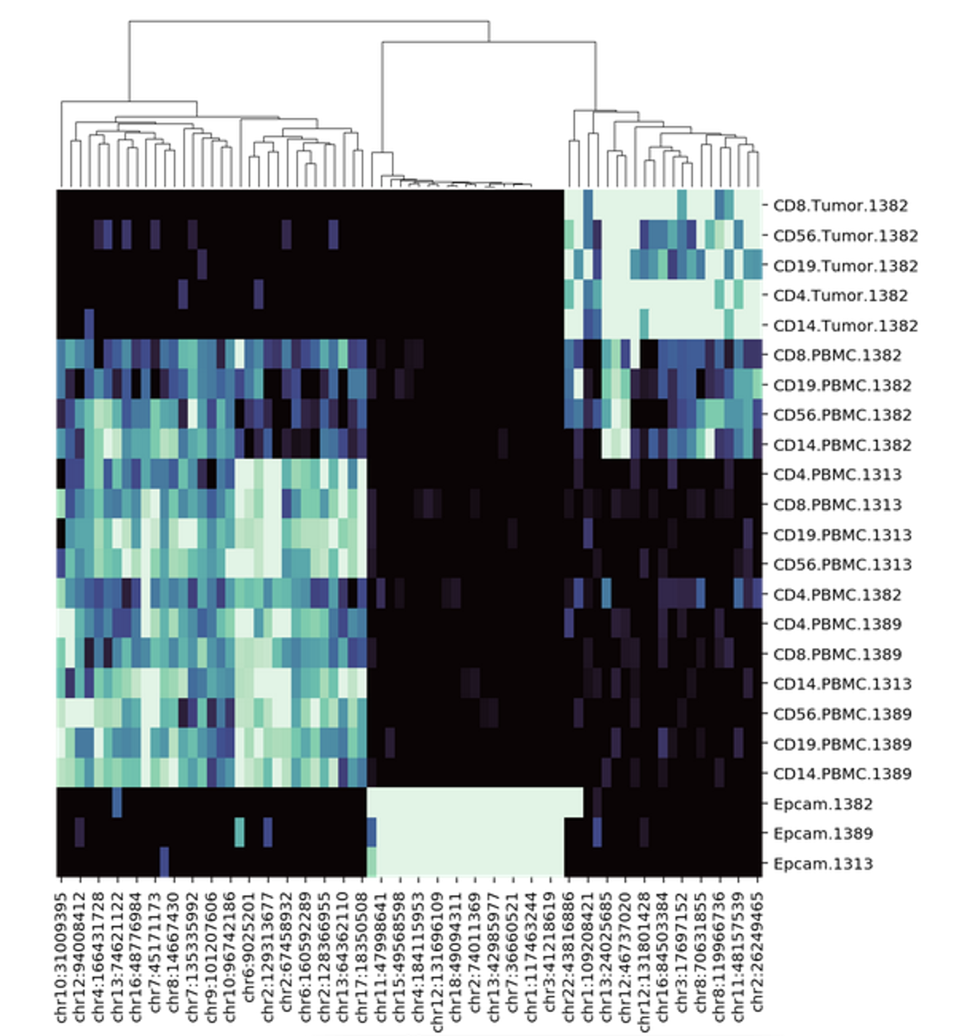
Cohen2, condition number. #cpg=75

Slide 4
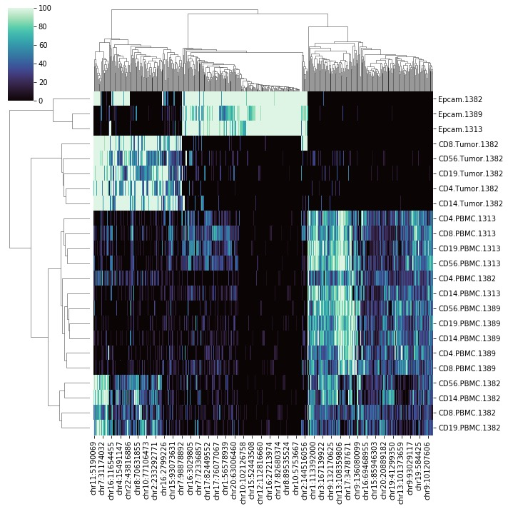
Effectsize, condition number
#cpg=100

Slide 5
Objective Functions
EffectSize:
For Every compartment c and for each CpG i Effect_{ci}=mean_{ci}/std_{ci}
Effect Size distance of the matrix= total pairwise Euclidean distance of Effect_{ci}
EffectSize_cosine:
In step 2 of the previous function take the cosine distance

Slide 6
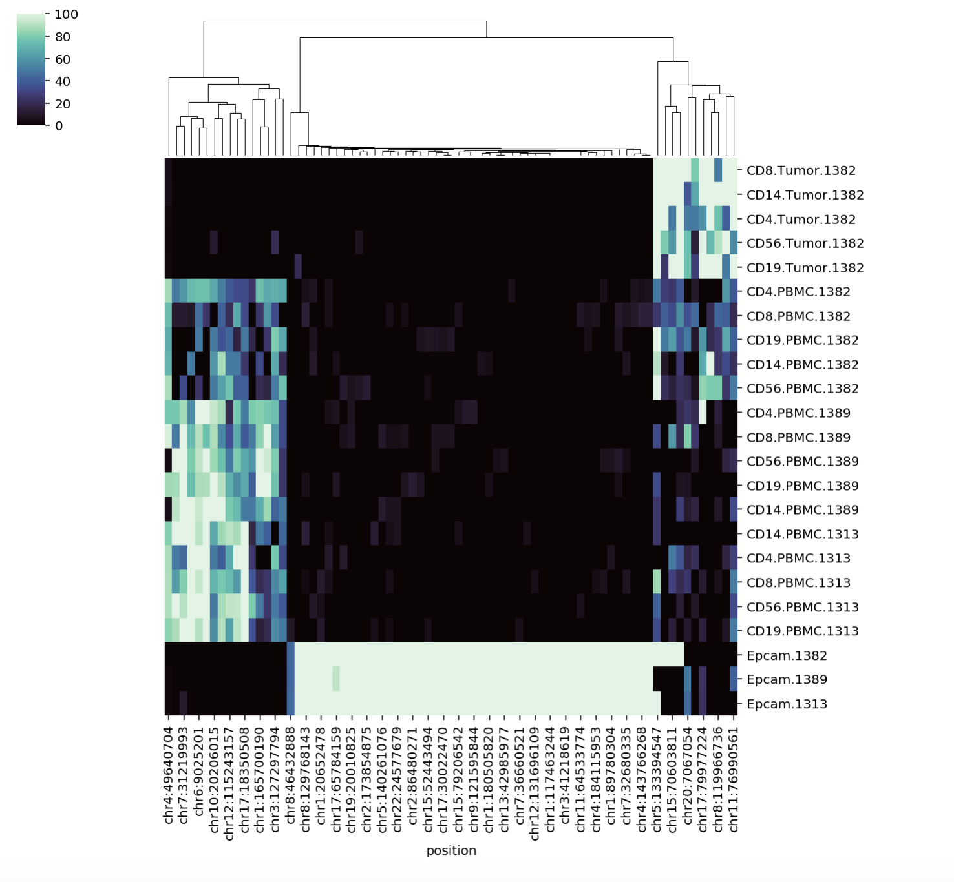
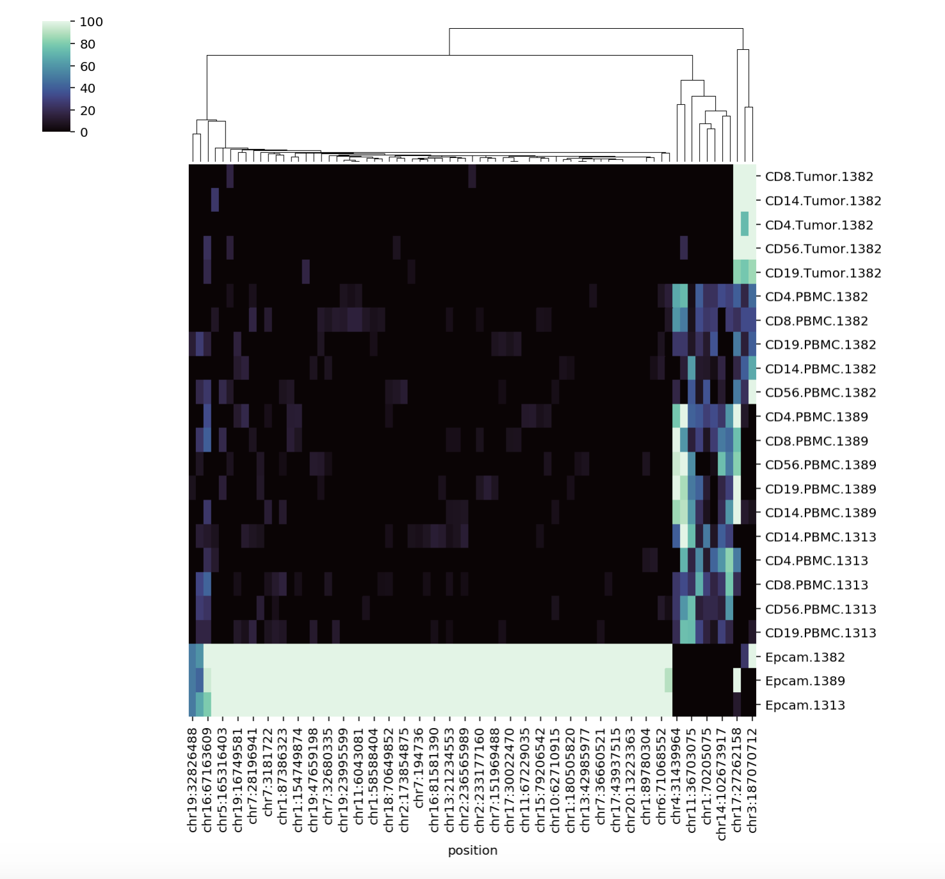
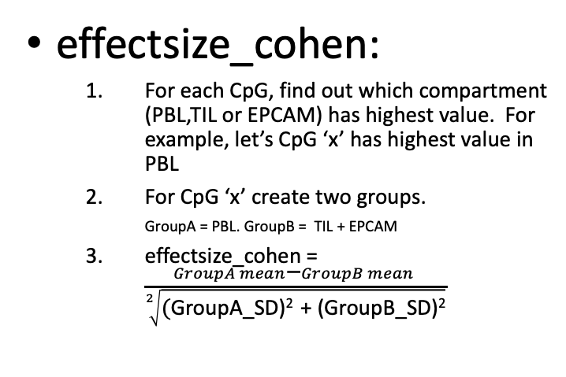
Objective Functions
SM from optimal cut point
SM from highest effectsize_cohen score
effectsize_cohen:
For each CpG, find out which compartment (PBL,TIL or EPCAM) has highest value. For example, let’s CpG ‘x’ has highest value in PBL
For CpG ‘x’ create two groups.
GroupA = PBL. GroupB = TIL + EPCAM
effectsize_cohen = $\frac{GroupA mean\text{− }GroupB mean }{\sqrt[2]{\text{(}\text{GroupA}\text{_}\text{SD}\text{)}\text{2 }\text{+ }\text{(}\text{GroupB}\text{_}\text{SD}\text{)}\text{2}}}$
Condition number=3.05
effectsize_cohen score =3183.27
Condition number=7.534
effectsize_cohen score= 3664.7
Problem: Can be unbalanced

Slide 7
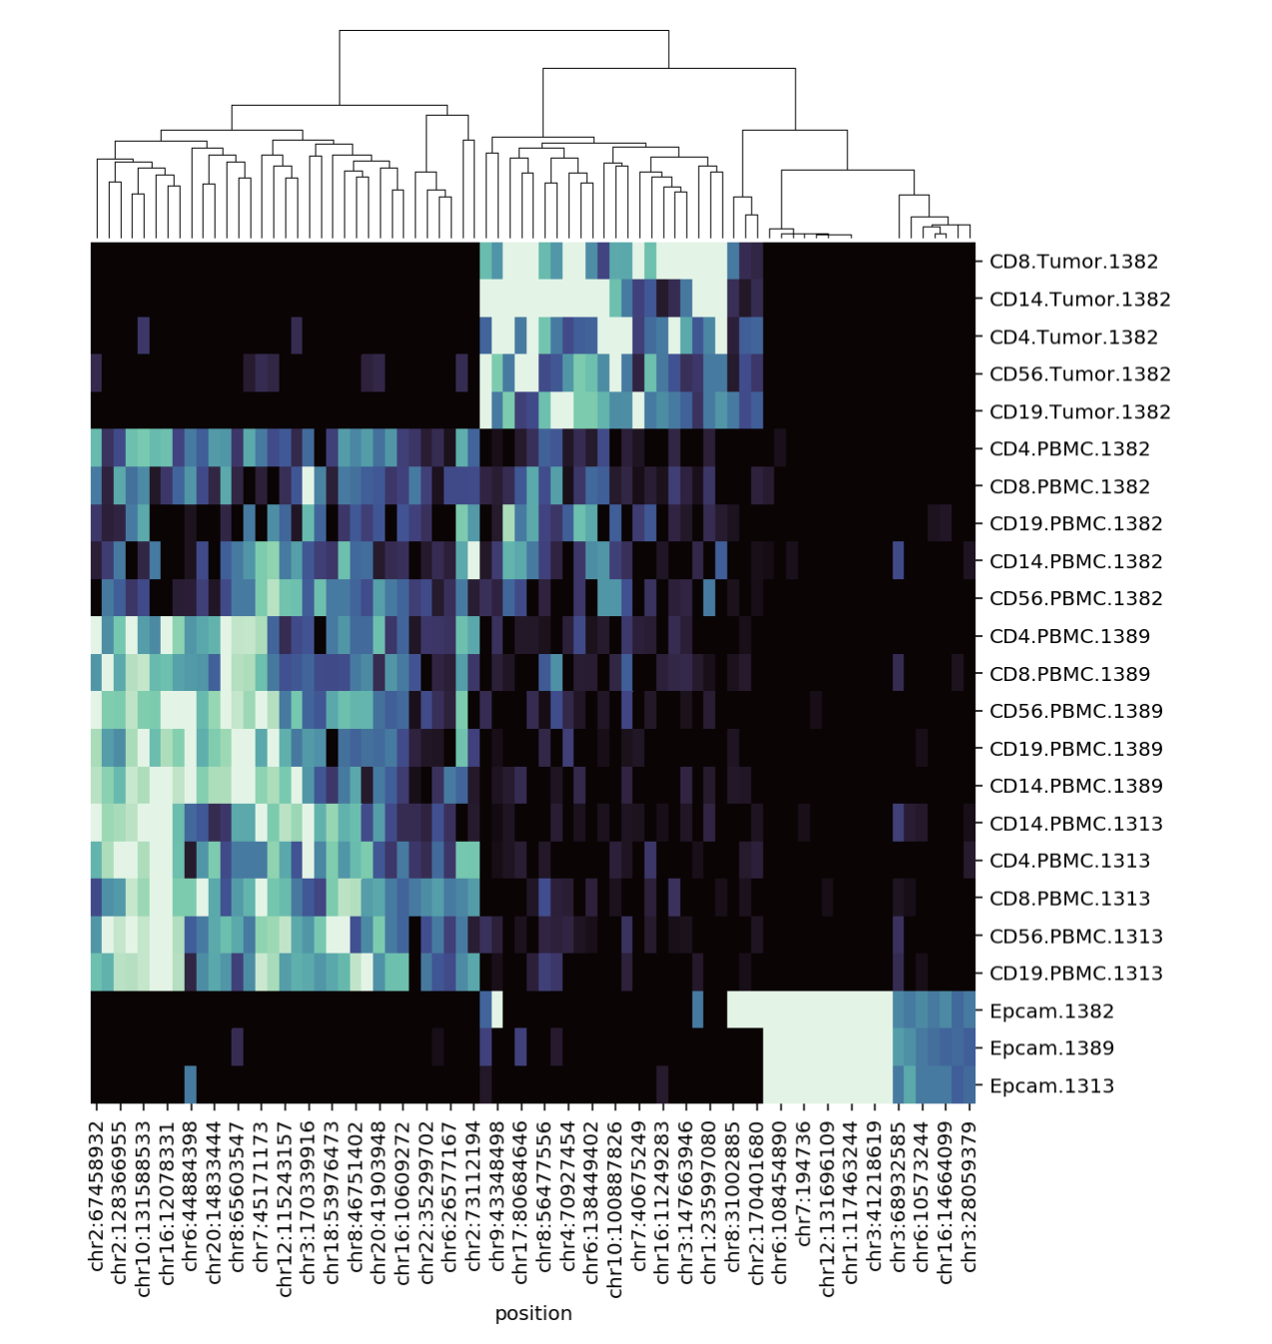
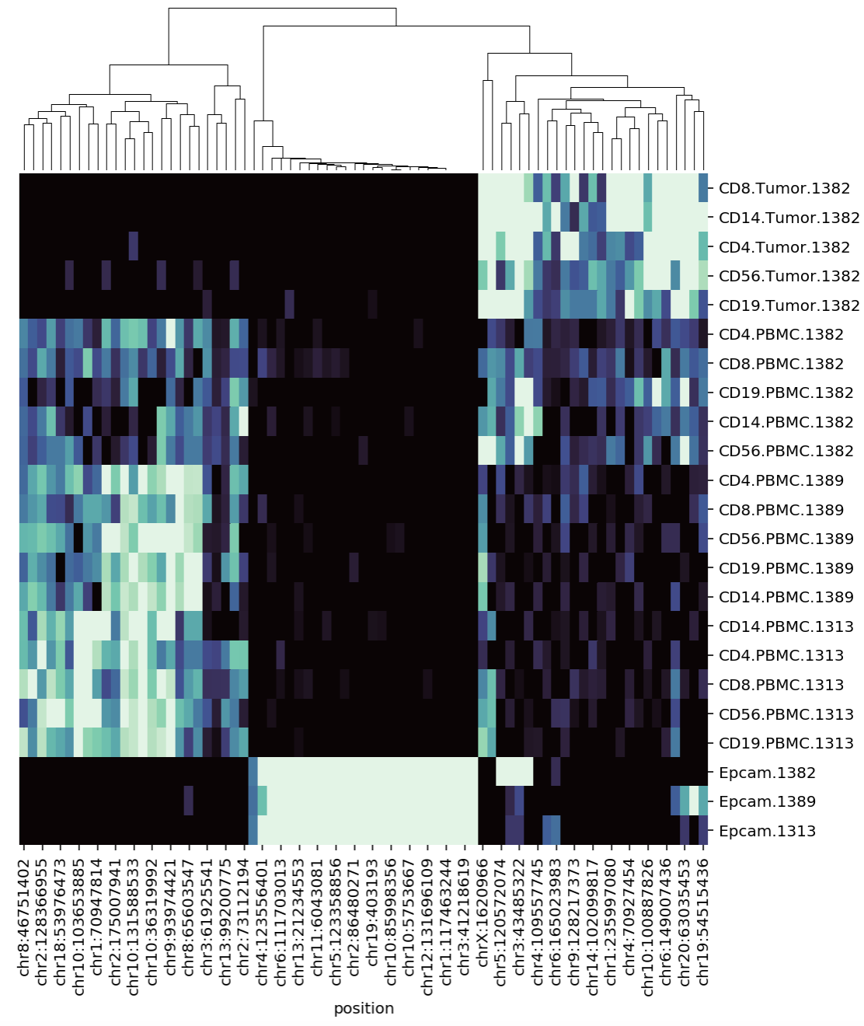
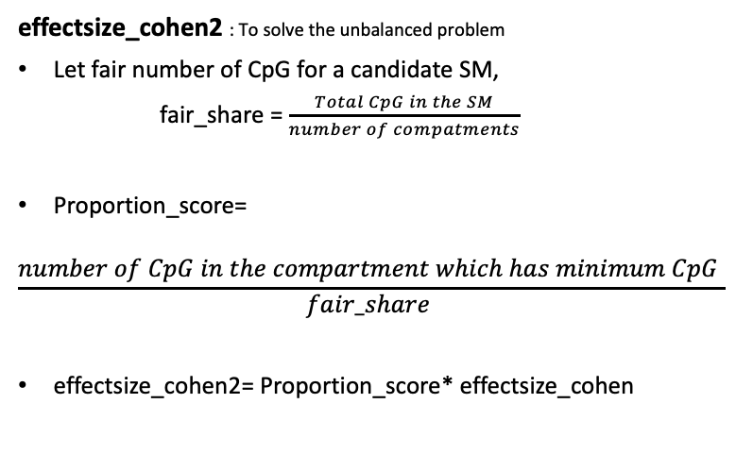
Objective Functions
SM from optimal cut point
SM from highest effectsize_cohen2 score
effectsize_cohen2 : To solve the unbalanced problem
Let fair number of CpG for a candidate SM,
fair_share = $\frac{Total CpG in the SM}{number of compatments}$
Proportion_score=
$$\frac{number of CpG in the compartment which has minimum CpG }{fair_share }$$
effectsize_cohen2= Proportion_score* effectsize_cohen
Condition number= 1.27
Effectsize_cohen2 score= 1148.36
Condition number= 1.67
Effectsize_cohen2 score= 2093.3
Let’s compare this SM with our original one

Slide 8
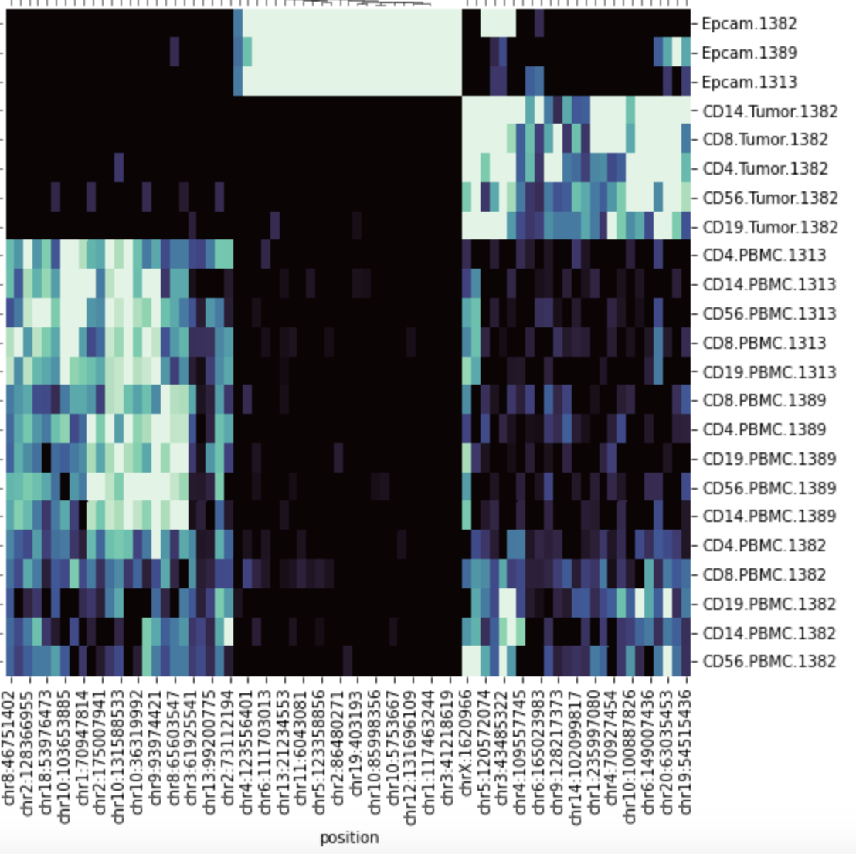
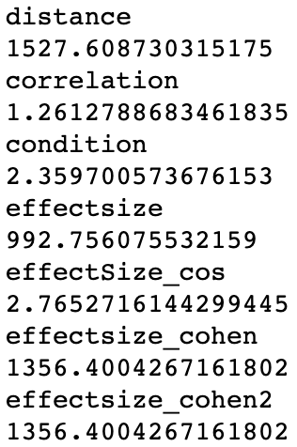
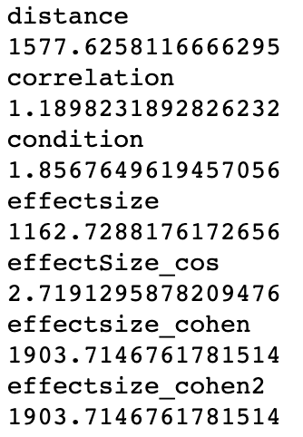

Original SM
SM from highest effectsize_cohen2 score
Our objective function can not capture the difference in TIL between two matrices
More sophisticated objective function?
First pairwise DMR analysis, then run GA.
Score of the Objective function
Score of the Objective function
Very Different Deconvolution Result
 | Original | SM from highest effectsize_cohen2 score
EPCAM | 0.76 | 0.59
TIL | 0.36 | - 0.0038

Slide 9
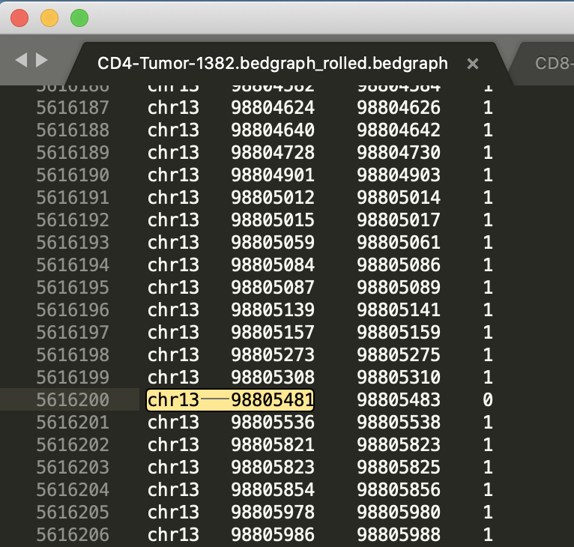
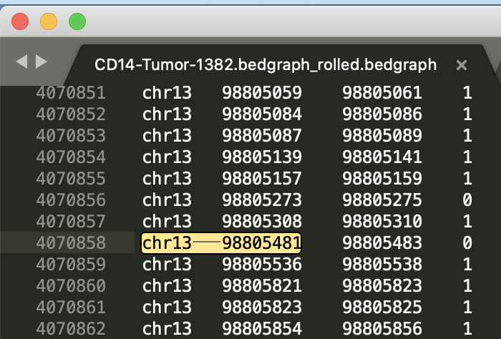
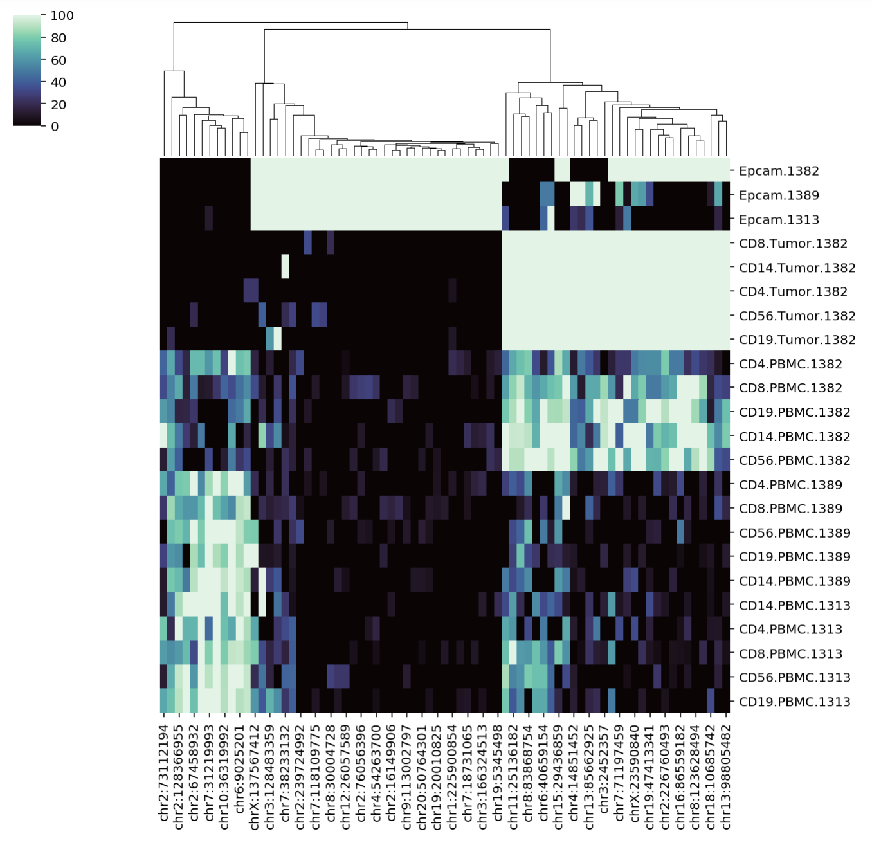
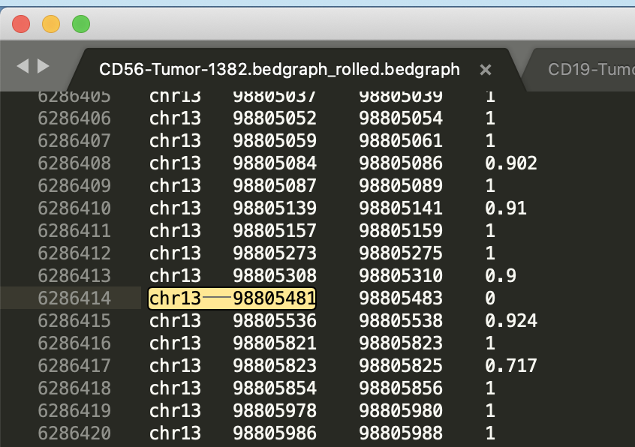
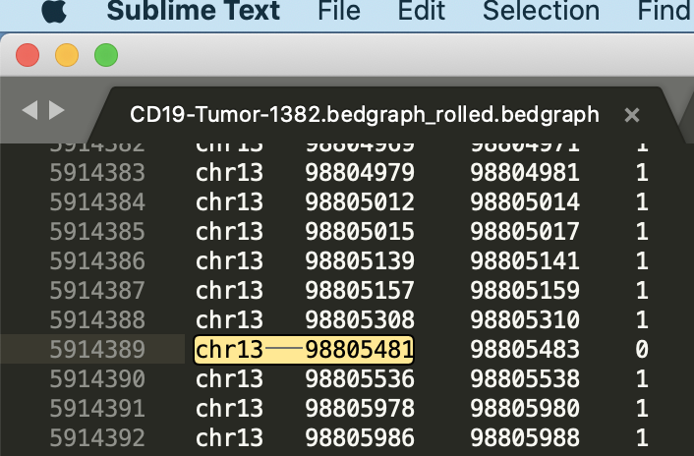
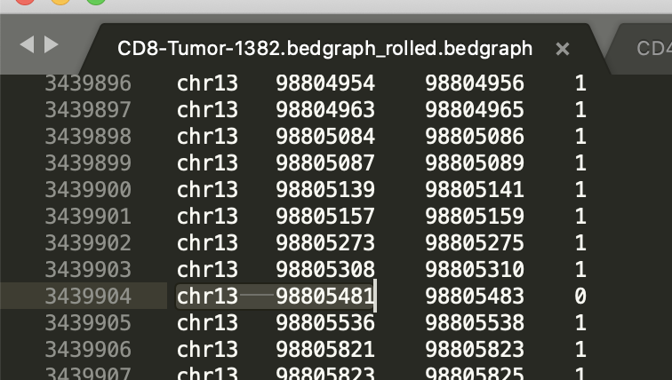
Anomaly?

Slide 10
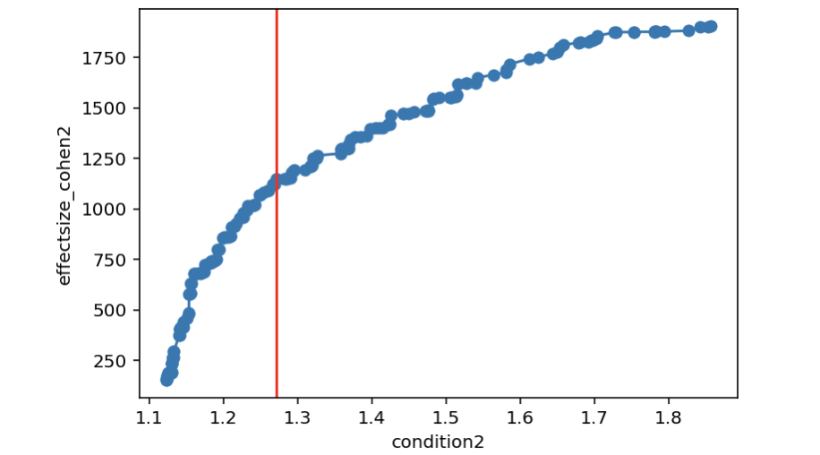
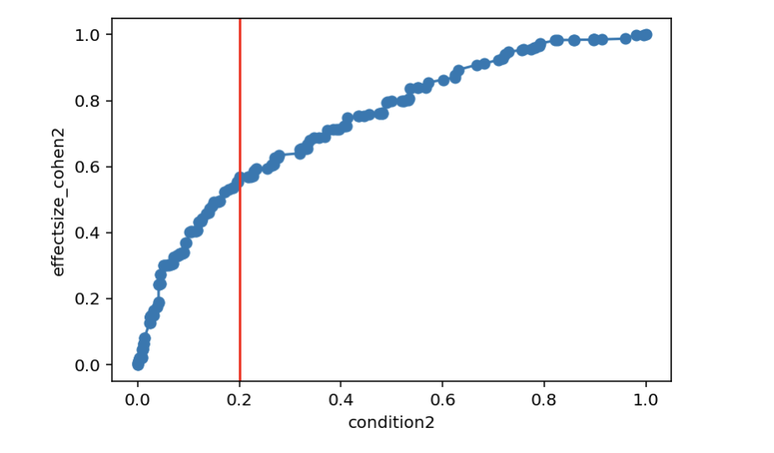
Optimal cutpoint

Slide 11
Objective Function | # of CpG | EPCAM correlation | TIL correlation
Effectsize, condition number | 100 | R=0.41,P=0.1 | R=0.48,P=0.095

Slide 12
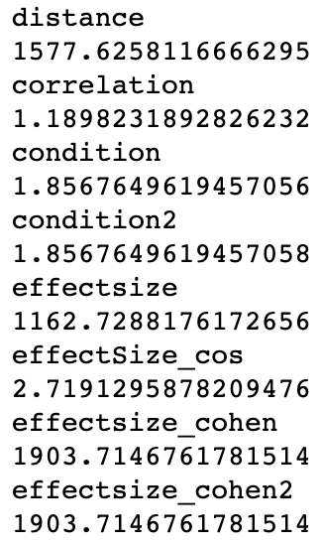
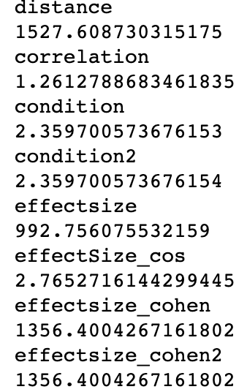
Original SM
SM from highest effectsize_cohen2 score

